Slide 1


Capstone Project Bike SHARING DEMAND Prediction (Supervised Machine Learning Regression)
Team Member:-
1) Kuresh Chandra Tripathy
2) N Santosh Kumar Choudhury

Slide 2
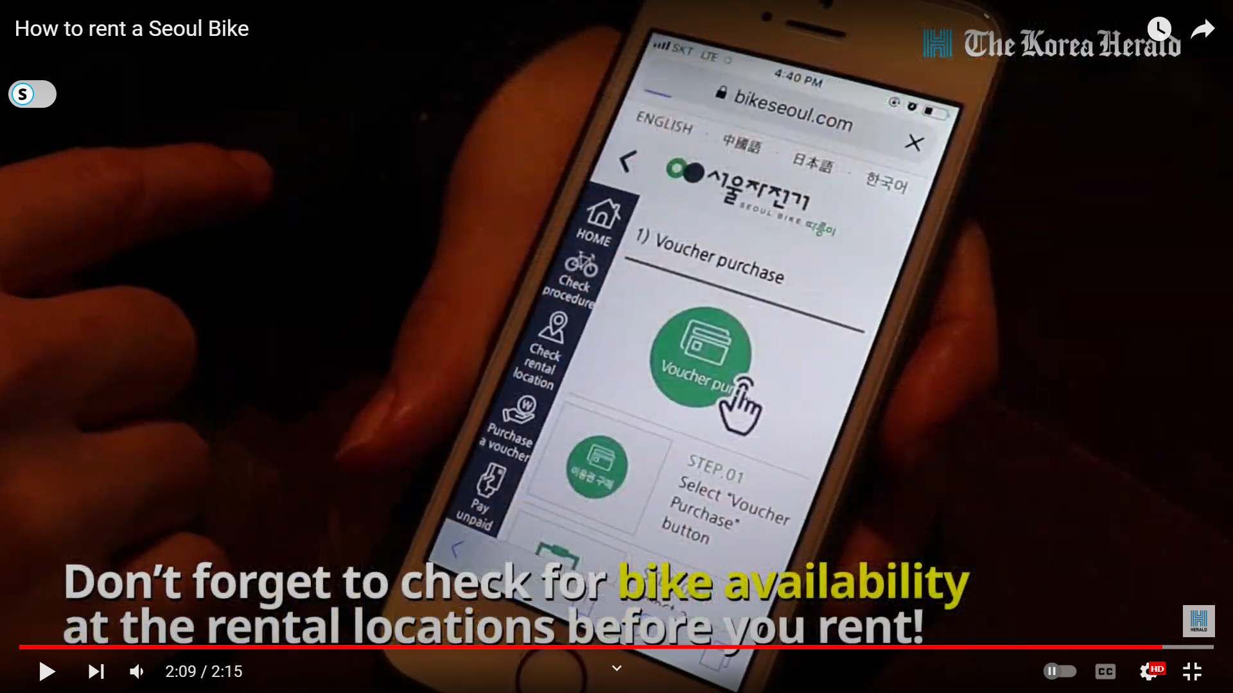
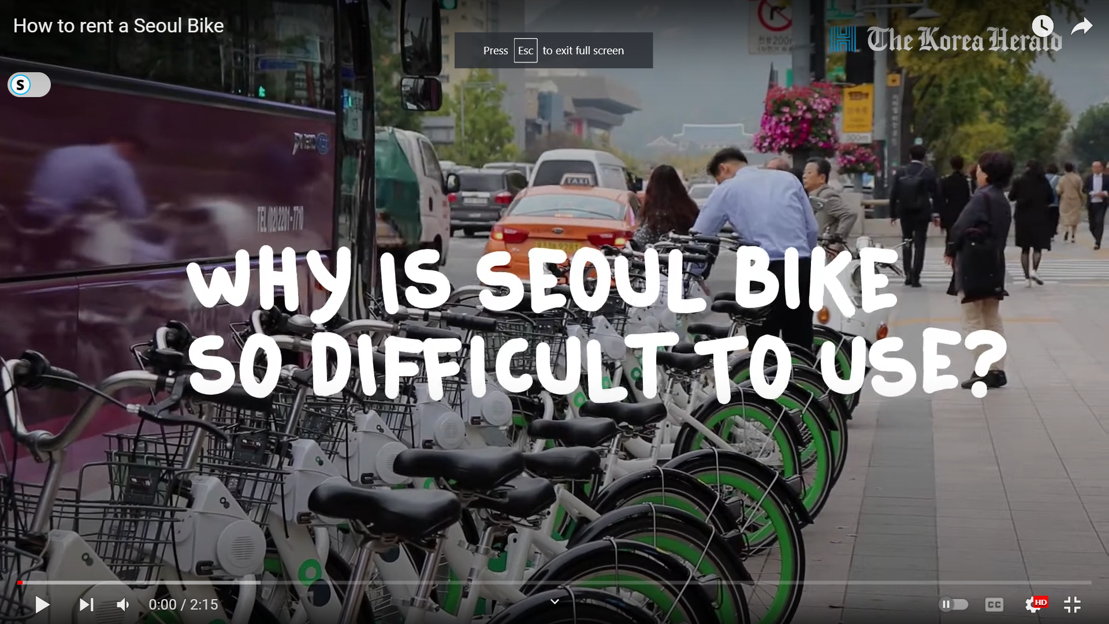
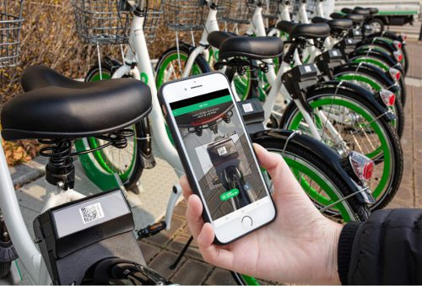
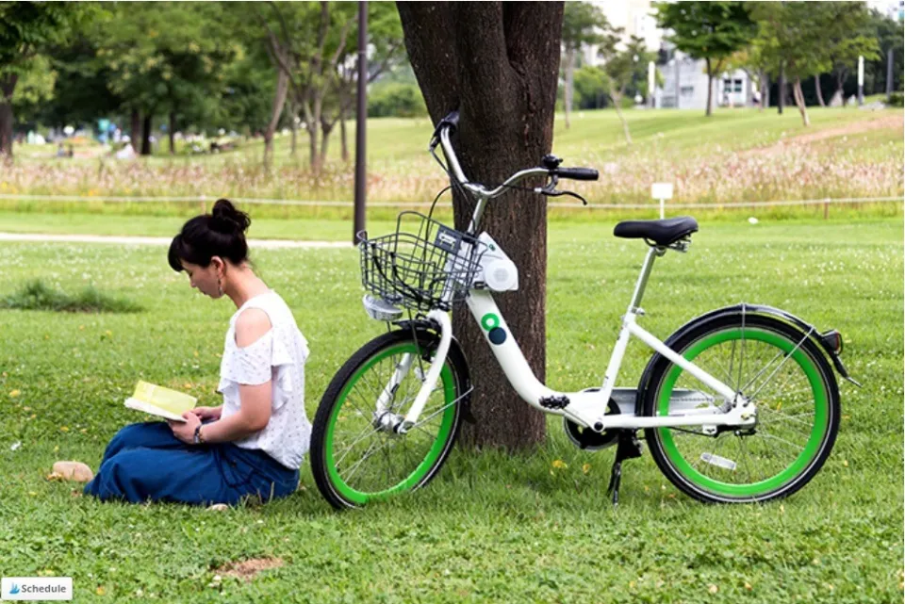
Points to Discuss:-
Agenda
Problem Statement
Workflow
Data Collection and Understanding
Data Wrangling & Feature Engineering
EDA
Preparation of data for model building. Some important questions
Model Selection and Evaluation
Conclusion

Slide 3
Agenda:-
To discuss the analysis of given prediction of bike count required at each hour for the stable supply of rental bikes.
We’ll be doing analysis of given data set in the following ways:-
Problem statement
Data Collection and Understating
Data Wrangling & Feature Engineering
EDA
Preparation of data for model building.
Model Selection and Evaluation
Conclusions

Slide 4
Problem Statement:-
Currently Rental bikes are introduced in many urban cities for the enhancement of mobility comfort.
It is important to make the rental bike available and accessible to the public at the right time as it lessens the waiting time. Eventually, providing the city with a stable supply of rental bikes becomes a major concern.
The crucial part is the prediction of bike count required at each hour for the stable supply of rental bike.
The final aim of this project is the prediction of bike count required at each hour for the stable supply of rental bikes by using suitable regression model.

Slide 5
Workflow:-
Data Collection and Understanding
Data Wrangling & Feature Engineering
EDA
Preparation of data for model building.
Model Selection and Evaluation
Conclusions

Slide 6
Data Collection and Understating:-
In the above Dataset we have given Seoul bike Data for our analysis and model building. There are 14 number of features, and 8760 observations are given in the SeoulBikeData.csv file.
The dataset generally contain target/dependent variable “Ranted bike count” and independent variable like weather information, and date information.
Date : year-month-day
Rented Bike count - Count of bikes rented at each hour
Hour - Hour of the day
Temperature-Temperature in Celsius
Humidity - %
Windspeed - m/s
Visibility - 10m
Dew point temperature - Celsius
Solar radiation - MJ/m2
Rainfall - mm
Snowfall - cm
Seasons - Winter, Spring, Summer, Autumn
Holiday - Holiday/No holiday
Functional Day – NoFunc (Non-Functional Hours), Fun(Functional hours)

Slide 7

Data Wrangling and Feature Engineering:-
As we know we had 8760 observations and 14 features.
Categorical Feature: Seasons, Holiday and Function Day.
Numerical Columns: Date, Hour, Temperature, Humidity, Wind speed, Visibility, Dew point temperature, Solar radiation, Rainfall, Snowfall, Rented Bike count .
Rename Columns: We renamed columns because they had units mentioned in brackets and was difficult to copy the feature name while working.

Slide 8
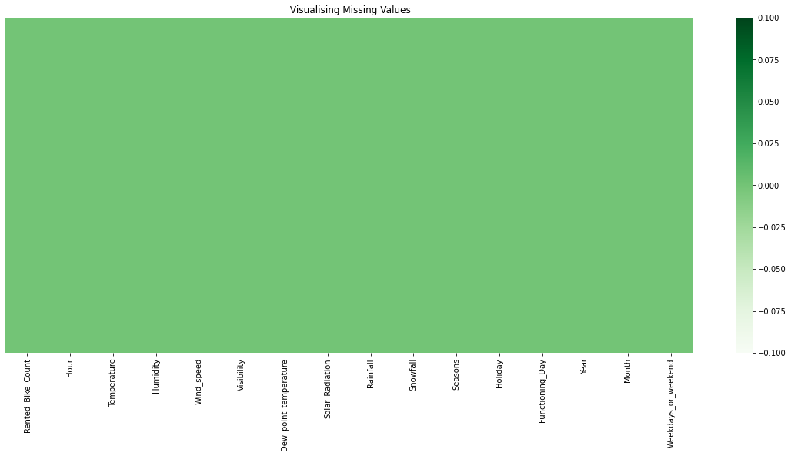
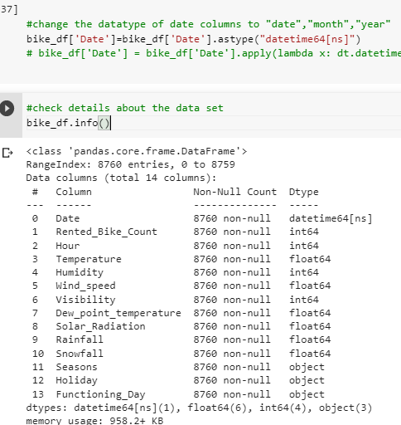
Data Wrangling and Feature Engineering:-
We had zero null values in our dataset.
Zero Duplicate entries found.
We changed the data type of Date column from ‘object’ to ‘datetime64[ns]’. This was done for feature engineering.
We Created two new columns with the help of Date column ‘Month’ and ‘Day’. Which were further used for EDA. And later we dropped Date column.

Slide 9
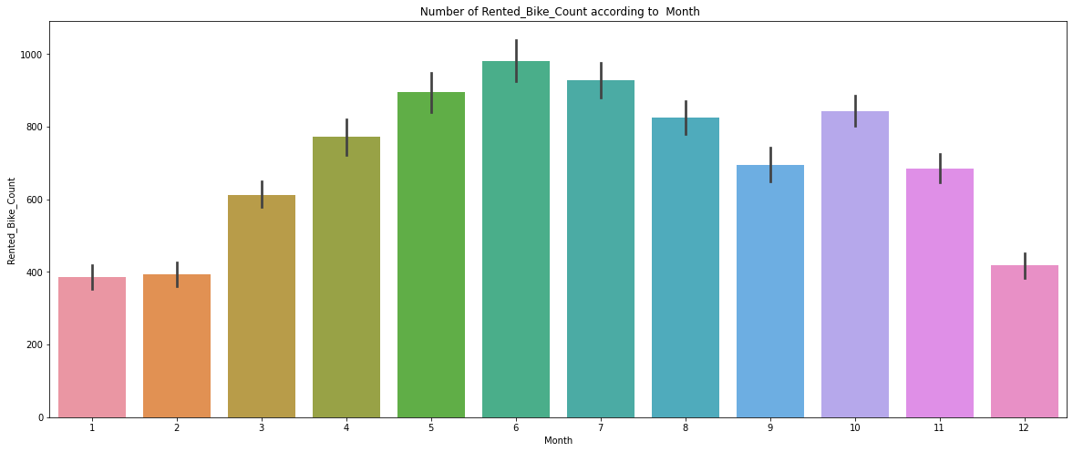
EDA (Exploratory Data Analysis):-
Relation of rented bike count with categorical features:
Rented bike vs Month
From the above bar plot is clearly showing that from Jan to Jun demand for the rented bike is growing high and then slowly the demand start dropping till Sep and than again a small demand increase for some a month and then it decrease.

Slide 10
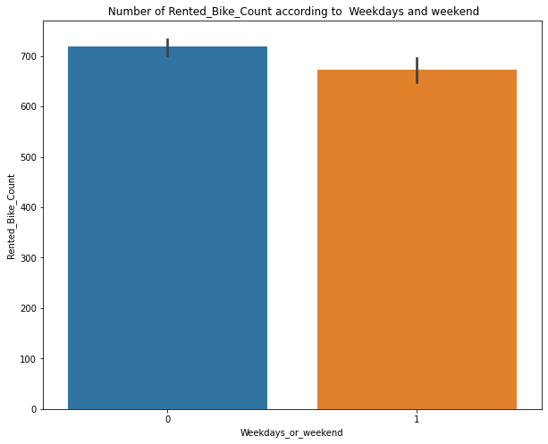
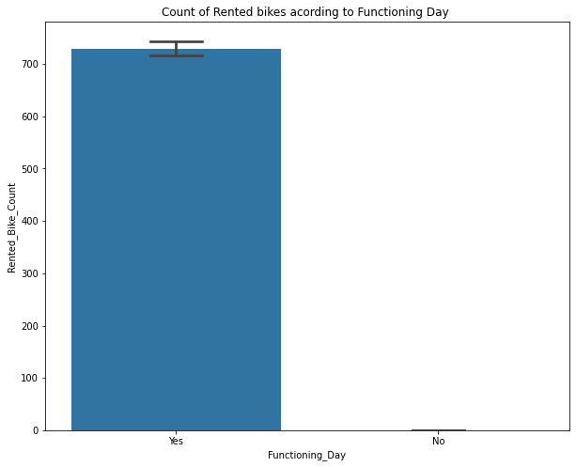
EDA (Exploratory Data Analysis):-
Rented bikes according to weekdays and weekend
From the above bar graph, it is show that in weekday and weekend days almost same demand for the bike is there.
Here 0= Weekdays and 1= Weekend
Rented bikes according to weekdays and weekend
In the above bar plot and point plot which shows the use of rented bike in functioning days or not, and it clearly shows that, Peoples don't use rented bikes in no functioning day.

Slide 11
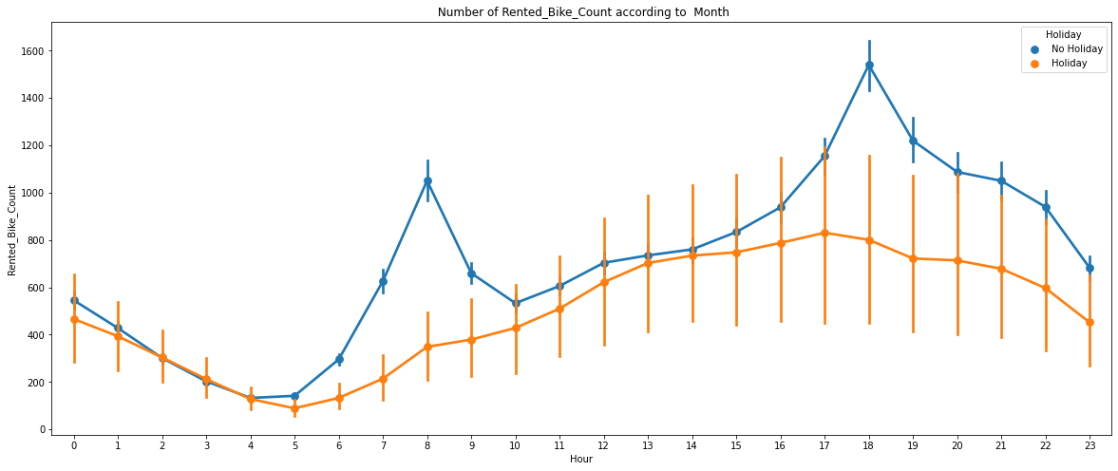
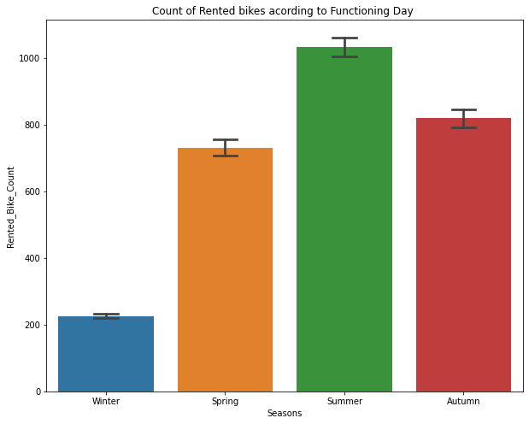
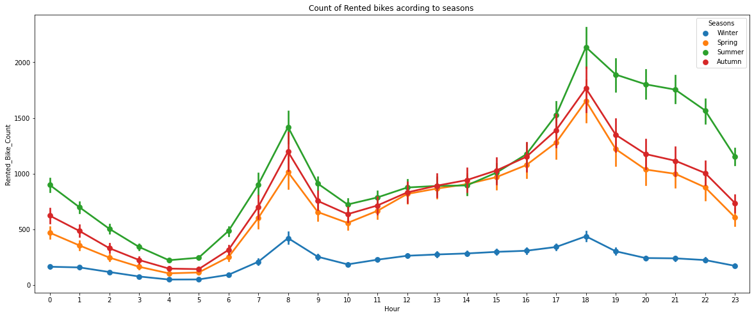
EDA (Exploratory Data Analysis):-
Rented bikes demand w.r.t hour on weekdays and weekends
From this point plot graph, we can see that on holiday ranted bike demand is less as compared to No-holiday. Between 7am-9am and 5pm-7pm demand of rented bike is high.
Rented bikes demand w.r.t Season
Form the bar chart and point plot we can clearly say that in Summer demand is high as compared to other season and in winter the demand is lowest.
Point chart also tell that in morning from 7-9am and 5-7pm demand is high in every season

Slide 12
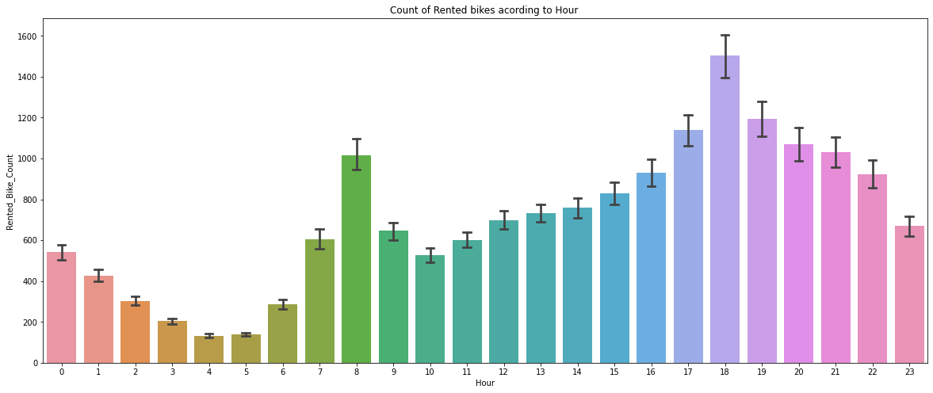
EDA (Exploratory Data Analysis):-
Rented bikes demand w.r.t hour
From this point plot graph, we can see that bike demand is high between 7am-9am and 5pm-7pm demand of rented bike is high. In between 3am-6am demand is low.

Slide 13
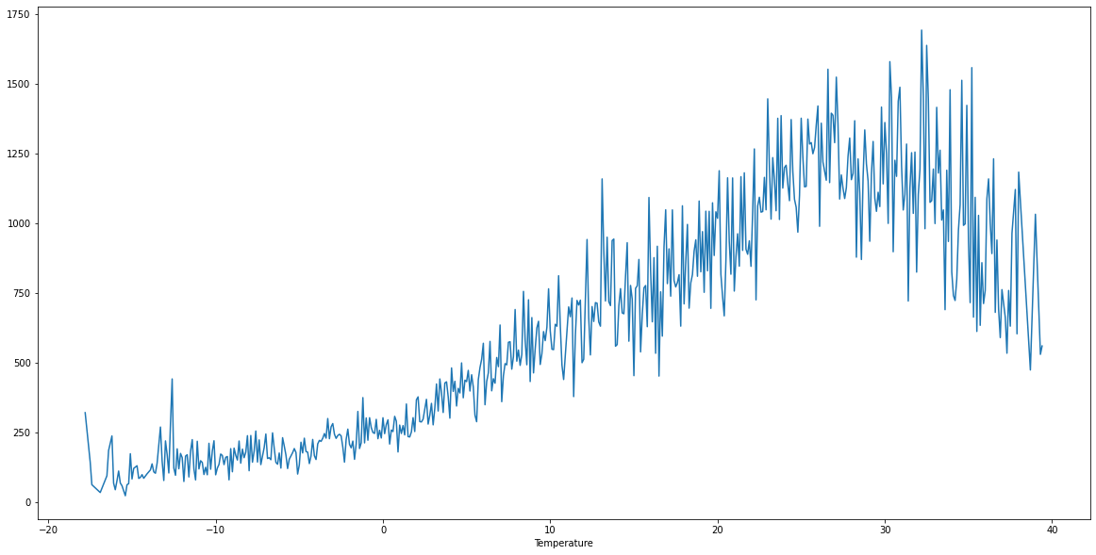
EDA (Exploratory Data Analysis):-
Relation of rented bike count with Numerical features:
Rented_Bike_Count V/s Temperature
Rented_Bike_Count V/s Dew_point_temperature
In this plot the demand of rented bike is highest when temperature is around 20°C-30°C.
This plot the demand of rented bike is highest when dew point temperature is around 20°C-30°C.
This graph also follow same trend as temperature.

